Slide 1
Bridging the Gap: Adapting Video Language Models for Egocentric Understanding
Final Update
Group 4: Michael Cruz, Christopher Lee, Saurabh Aggarwal, Robert Martin

Slide 2
Problem Statement and Objectives
Problem Statement
EgoCentric data has been overlooked by researchers
Overlooking EgoCentric may have negatively impacted existing methods
Utilizing EgoCentric data could extend capabilities of existing methods
Objectives
Benchmark existing LVLM’s on egocentric data (EgoSchema dataset)
Perform fine-tuning on egocentric data (Ego4D dataset)

Slide 3
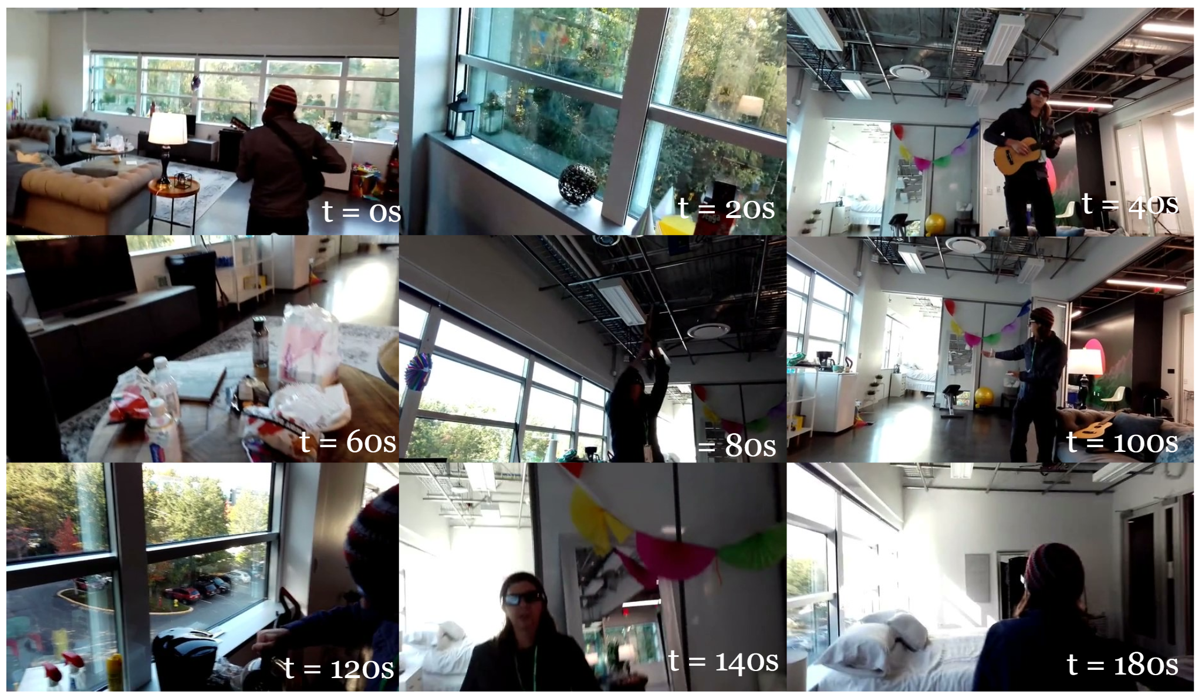
EgoCentric Video Data
Video from first person perspective
Potential Uses
AR/VR
Law Enforcement
Activity Recognition
Memory Enhancement
Navigation and Guidance

Slide 4
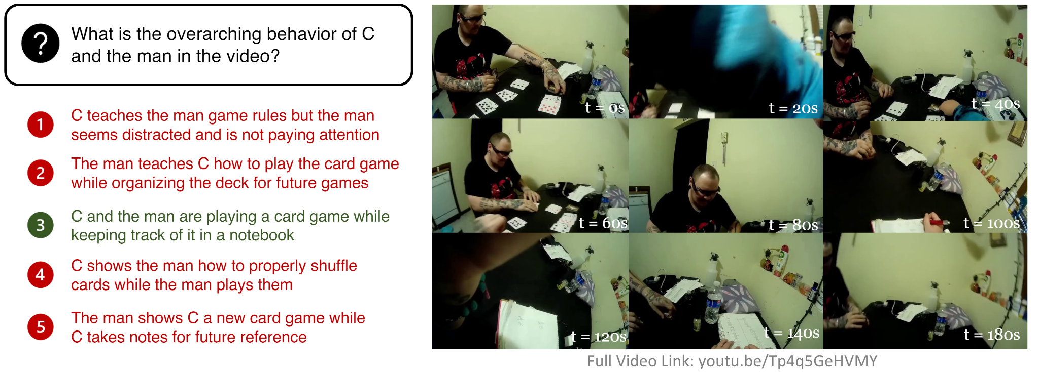
EgoSchema Dataset
Over 5000 human curated multiple choice question pairs
Subset of 500 pairs provided with answers

Slide 5
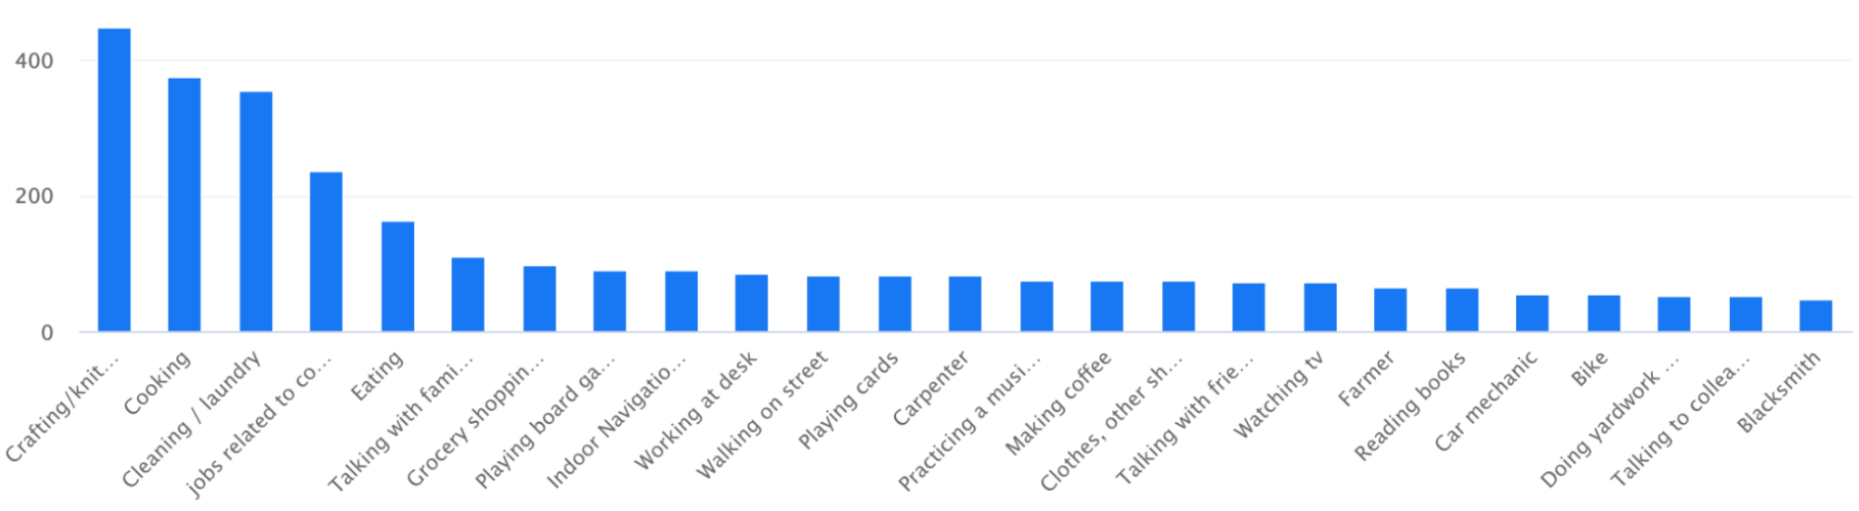
Ego4D Dataset
Data Types
Full Scale Videos
Clips
Annotations
Visualization Data
Video Components
Features

Slide 6
Experiments
Benchmarking on EgoSchema
Benchmark on the 500 multiple choice question pairs with answers
Record the accuracy achieved by LVLMs
Fine-tuning on Ego4D
Fine-tune on the full scale videos
Create fine-tuning data using the Ego4D narration annotations

Slide 7
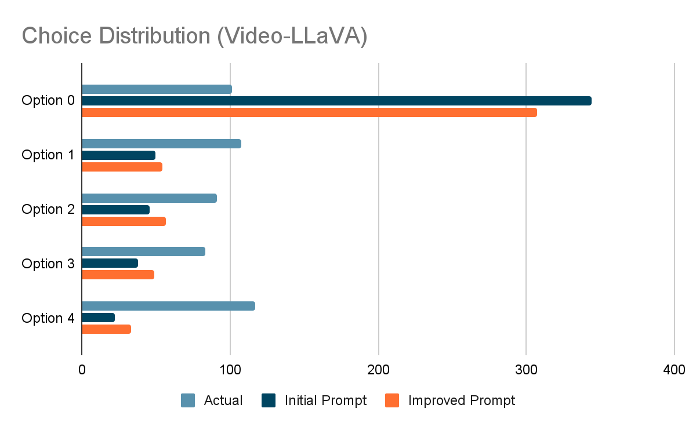
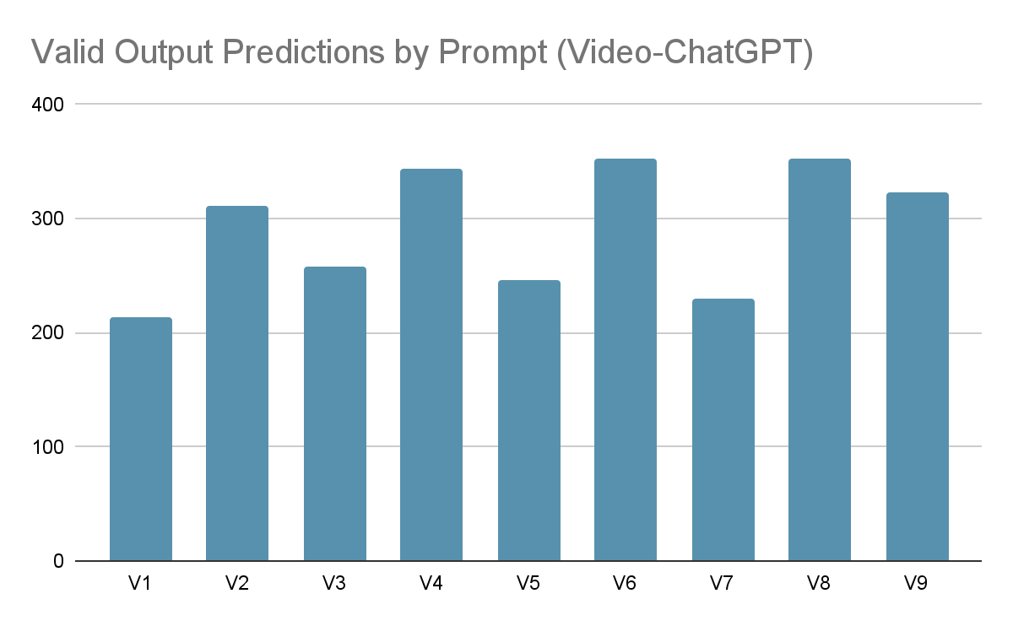
Prompt Engineering for Benchmarking
General Formatting
Combating Choice Bias
Optimizing for Desired Outputs

Slide 8
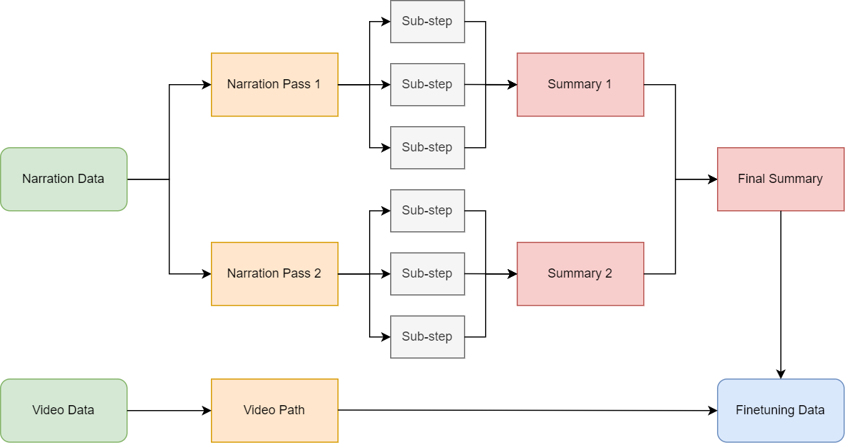
Finetuning Data Generation

Slide 9
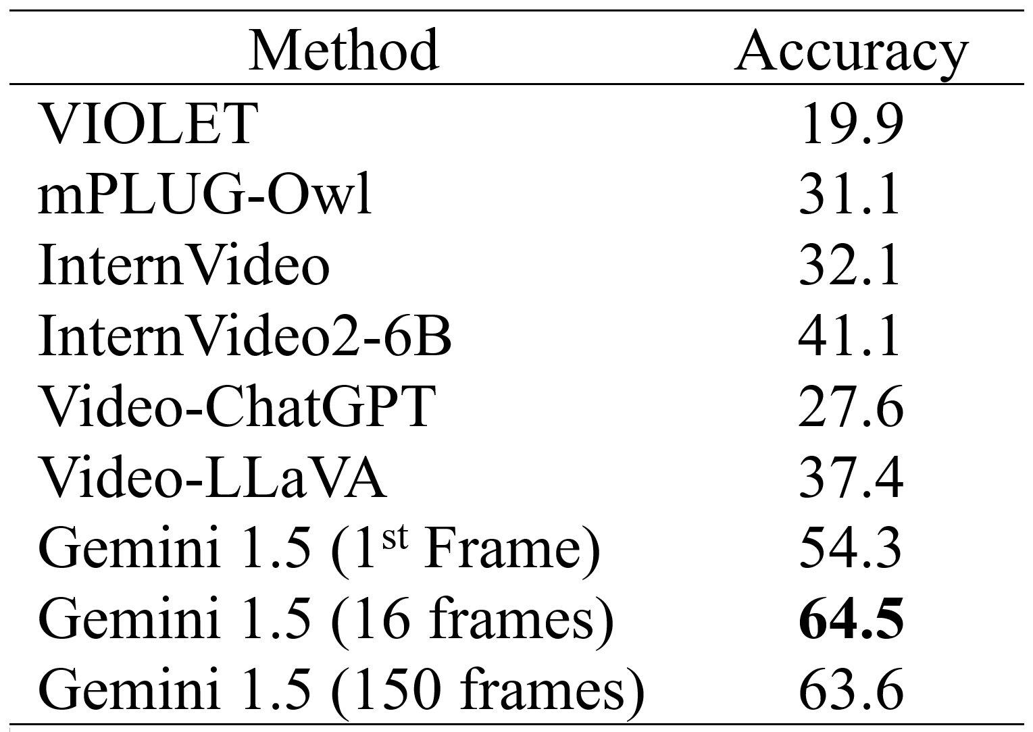
Experimental Results
Achieved commendable results on EgoSchema
Finetuning results were not fully completed

Slide 10
Limitations
Uniform selection of frames for tuning
Reliance on narration annotations from Ego4D
Commendable performance in zero-shot multiple choice VQA
Bias is choice selection
Difficulty generating valid outputs

Slide 11
Conclusion
Extended LVLM’s for Long-Context Video Question Answering (EgoSchema)
Developed a fine-tuning scheme using Ego4D narration annotations
Obtained commendable benchmark results
Made significant progress towards completing fine-tuning

Slide 12
Future Work
Narration-based frame selection (nonuniform)
Exploring fine-tuning for specific Ego4D benchmark tasks
Creating improved narration annotations for Ego4d using a different method
Notes:
8 frames grab the small summary rather than what could be contained in the
Generated 1 summary and compared with original summary, whichever had most detail woohoo that’s the summary to use with the conversation. Asked a single question
Experimented with narration file, best combination of xyz
For future work:
VideoGPT would need a custom function
Introduction (goals had before going in)
Egoschema dataset
Ego4d dataset
How we did our benchmarks
How we did our finetuning
Prompt engineering for finetuning
Adjust to get videochatgpt working
500 subset of videos
Adjust to get videollava working
Results
Show how benchmarking wasn't good before finetuning
VideoLLava based on VideoChatGPT
Uses existing finetuning process but coming up with our finetuning annotations and finetuning inputs
So we have narrations for the full video
380 videos downloaded
time constraints to train on 5000 egocentric video
trial and error
configuration with different settings
because finetuning was

Slide 13
References
[1] Lin, Bin, et al. "Video-llava: Learning united visual representation by alignment before projection." arXiv preprint arXiv:2311.10122 (2023). [2] Maaz, Muhammad, et al. "Video-chatgpt: Towards detailed video understanding via large vision and language models." arXiv preprint arXiv:2306.05424 (2023). [3] Shen, Junxiao, John Dudley, and Per Ola Kristensson. "Encode-Store-Retrieve: Enhancing Memory Augmentation through Language-Encoded Egocentric Perception." arXiv preprint arXiv:2308.05822 (2023). [4] Pramanick, Shraman, et al. "Egovlpv2: Egocentric videolanguage pre-training with fusion in the backbone." Proceedings of the IEEE/CVF International Conference on Computer Vision. 2023. [5] Qinghong Lin, Kevin, et al. "Egocentric Video-Language Pretraining." arXiv e-prints (2022): arXiv-2206. [6] Jia, Baoxiong, et al. "Egotaskqa: Understanding human tasks in egocentric videos." Advances in Neural Information Processing Systems 35 (2022): 3343-3360. [7] Xue, Zihui, et al. "Egocentric video task translation." Proceedings of the IEEE/CVF Conference on Computer Vision and Pattern Recognition. 2023. [8] Tang, Yunlong, et al. "Video understanding with large language models: A survey." arXiv preprint arXiv:2312.17432 (2023). [9] Antol, Stanislaw, et al. "Vqa: Visual question answering." Proceedings of the IEEE international conference on computer vision. 2015. [10] "Pre-Annotations Narrations." Annotation Guidelines Ego4D, ego4d-data.org/docs/data/annotationguidelines/#pre-annotations-narrations. [11] "DoMSEV Dataset." Papers with Code, paperswithcode.com/dataset/domsev. [12] "Ego4D Dataset." Papers with Code, paperswithcode.com/dataset/ego4d. [13] "EOAD (Egocentric Outdoor Activity Dataset)." Zenodo, zenodo.org/records/7738719. [14] Wang, Yi, et al. "InternVideo2: Scaling Video Foundation Models for Multimodal Video Understanding.” https://doi.org/10.48550/arXiv.2403.15377, (2024). [15] Reid, Machel, et al. ‘Gemini 1.5: Unlocking Multimodal Understanding across Millions of Tokens of Context’. http://arxiv.org/abs/2403.05530. arXiv, (2024). [16] Mangalam, Karttikeya, Raiymbek Akshulakov, and Jitendra Malik. "Egoschema: A diagnostic benchmark for very long-form video language understanding." Advances in Neural Information Processing Systems 36 (2024).

Slide 14
Questions?

